Slide 1
The Complete Front-End Development course
CSS3

Slide 2
Module 3
Basics of CSS3
CSS selectors and properties
Inline, internal and external CSS
The 'Box model'
CSS sizing methods
CSS positioning systems
CSS float and clear
Pseudo classes and pseudo elements
Class vs. ID
CSS rule conflict resolution.
Transitions
Animations
Pagination
2D transforms
3D transforms
Responsive web design- The Grid system, Flexbox, Media Queries
CSS coding best practices

Slide 3


Basics of CSS3
Cascading Style Sheets
Why CSS?
background-color: rgb(255, 99, 71)
"border: 2px solid Blue;“
"color: Red;“
Opacity / Transparency
/* comment */
Notes:
using tables to layout and html tags to describe style becomes too verbose and highly complicated for modern websites. Hence CSS was reqd.
use pigments extension of vscode to see color in code
Show https://developer.mozilla.org/en-US/docs/Web/CSS/color_value

Slide 4
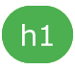
CSS anatomy
{color: red; font-style: “Arial”;}
Selector {Declarations}
Notes:
https://colorhunt.co/ for selecting a color palette for website
body { background-color: lightblue; } h1 { color: white; text-align: center; } p { font-family: verdana; font-size: 20px; }
background: #ffffff url(“1.png") no-repeat right top;
background-color: #ffffff; background-image: url(“1.png"); background-repeat: no-repeat; background-position: right top;
border: 5px solid red;
text-align: center; text-decoration: underline; text-transform: capitalize; text-indent: 50px; letter-spacing: 3px; line-height: 0.8; word-spacing: 10px;
html { background: url(2.jpg) no-repeat center fixed; background-size: cover; }
https://developer.mozilla.org/en-US/docs/Web/CSS/border-style different borders

Slide 5
Fonts
font-style
font-variant
font-weight
font-size : 1 vw
line-height
font-family: font1, font2, Serif or Sans Serif
font: italic small-caps bold 12px/30px Georgia, serif;
Web safe fonts
Text-decoration:none
Notes:
font-family: font1, font2, Serif or Sans Serif //put so that first search font1, if not available then font2 etc
Cssfontstack.com for help in this
It should not look very different in each font so use web safe fonts for max chance of getting it rendered correctly.
Fonts.google.com- copy and paste fav font link in your site for same font for everyone
Font size- vw font size relative to the screen width- 1 vw= 1% of viewport width

Slide 6
CSS properties
background-image: linear-gradient(direction, color-stop1, color-stop2, ...);
background-image: radial-gradient(shape size at position, start-color, ..., last-color);
hr {width:50%;}
Text-shadow
Box-shadow
Notes:
You would not remember all properties and values then go to documentation or simply google for it.
Hr width:50% for center division line.

Slide 7
CSS selectors and properties
Element
ID
Class
Universal *
Group- h1, h2, p { text-align: center; color: red; }

Slide 8
Pseudo classes and pseudo elements
selector[:pseudo-class] [::pseudo-element] eg. a:hover {}, h1::before {}
pseudo-class is used to define a special state of an element
pseudo-element is used to style specified parts of an element.
style HTML elements that have specific attributes or attribute values. a[target="_blank"]

Slide 9
Class vs. ID
.classname
#idname
Classes and IDs are more specific than the tags on which they are put.
Multiple HTML elements can share the same class. An element can have multiple classes.
Value for ID should be unique in the entire HTML document.
Notes:
So they will override them.
Classes used mostly for CSS styling. ID used mostly for scripting.

Slide 10

Inline, Internal and External CSS
Priority
Inline style (inside an HTML element)
Then internal style sheets (in the head section)
Then External
Then Browser default
Notes:
Inline is too cumbersome to include at all places and not maintainable to make common changes. Makes code ugly, not good for separation of concerns.
Even internal across all pages is lot of repetition.
<link rel="stylesheet" type="text/css" href="mystyle.css">
Paths- css/x.css and /css/x.css difference

Slide 11
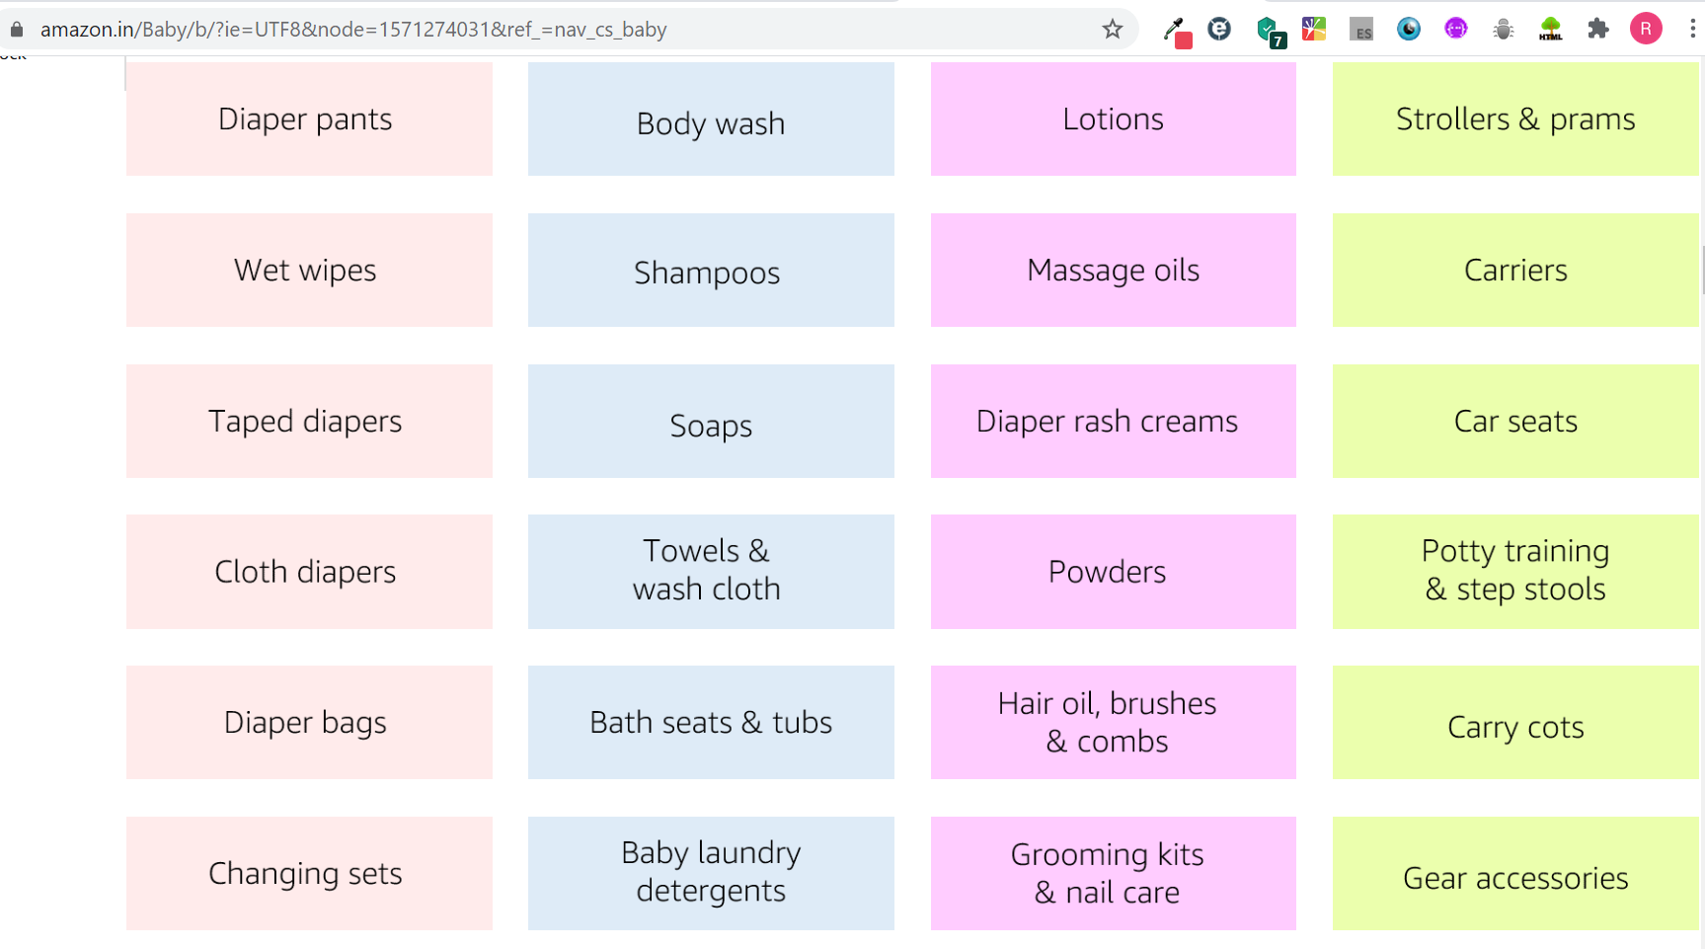
Table Styling
Notes:
table { border-collapse: collapse;
width: 100%; }
th, td { padding: 15px; text-align: left; }

Slide 12
What can CSS do?
Element position in document flow
Element size
Font sizing
Debugging
Notes:
Devdocs.io for all documentation
Element position in document flow- Pesticide chrome extension will highlight all boxes on the webpage.
Element size- % for height width due to diff screen sizes instead of px hard
Font sizing can use exact px which wont change with user settings, if need dynamic or inherited relativity then use % or em. If agnostic to parent relativity then use rem. 1 em=16px
Debugging style in chrome

Slide 13
Advance CSS selectors
h1.classname{} // without space
descendant selector (space)
child selector (>)
adjacent sibling selector (+)
general sibling selector (~)

Slide 14
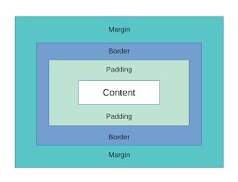
The 'Box model'
For two elements- Top and bottom margins overlap, the margins don’t add. The larger margin wins.
Notes:
http://markusvogl.com/web1/interactive_box_model/css_box_demo.html
margin: 25px 50px 75px 100px;
padding: 25px 50px 75px 100px;
width: 300px; padding: 25px; box-sizing: border-box; //forces max width 300
width: 300px; // only content area border: 15px solid green; padding: 50px; margin: 20px; // so total width is 470 px
h1 {
width: 300px;
/* only content area */
border: 15px solid green;
padding: 50px;
margin: 20px;
/* so total width is 470 px */
}

Slide 15
Box Sizing
box-sizing: content-box / border-box
Box Sizing is not an inherited property.
Can use * selector for applying box sizing type to all.
Notes:
Content and border box- https://developer.mozilla.org/en-US/docs/Web/CSS/box-sizing

Slide 16
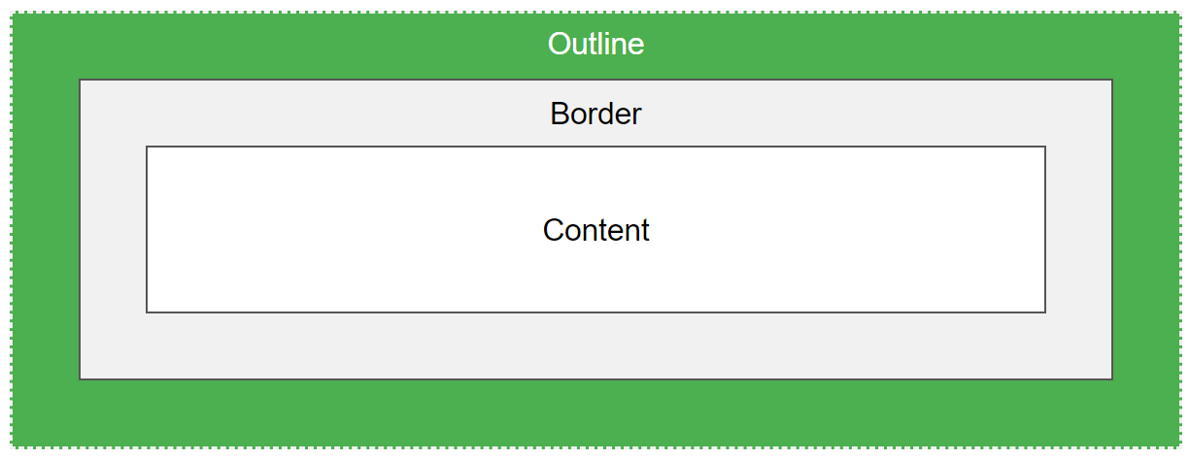
Outline
Outline is not a part of the element.
May overlap other elements.

Slide 17
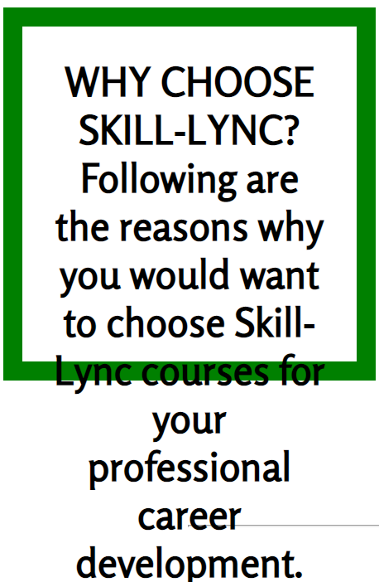
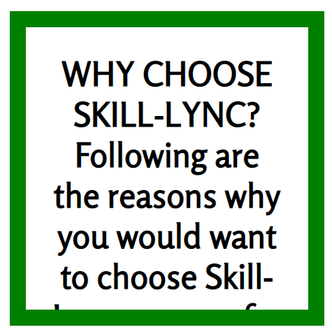
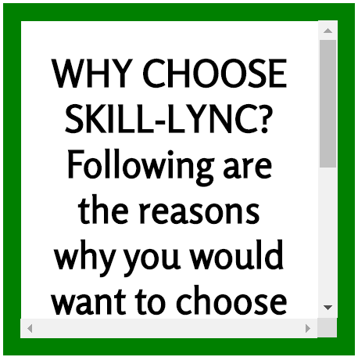
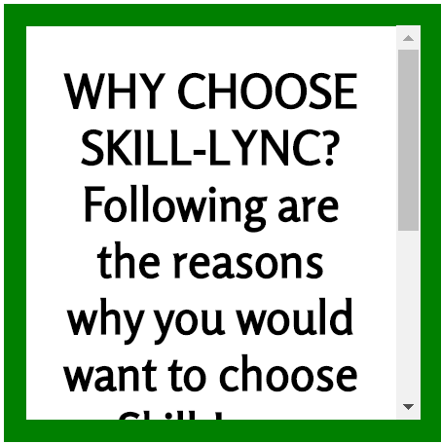
Overflow
overflow, overflow-x, overflow-y:
visible - Default.
hidden
scroll
auto

Slide 18
CSS sizing methods
px
pt
em
rem
vw
%

Slide 19
CSS positioning systems
Position:
Static
Relative
Absolute
Fixed
Sticky
Text-align: center
Margin: auto
Display:
Block
Inline
inline-block
none- to hide
Visibility: hidden
Notes:
Img/div{left/right/top/bottom: 20px;} // show right specially to make it vanish from page.
Add margin and show
Put negative values
Make position relative and absolute for all these combinations.
Show how absolute positioning takes it out of document flow.
position: static by default
Relative positioning keeps the space and moves the element
Absolute positioning doesn’t keep any space and moves element where mentioned
Absolute positioning is relative to the parent div which should necessarily have position: relative.
Fixed is fixed even on scrolling. Eg nav bar
position: sticky; // is relative unless scrolling then it sticks
Relative positioning, can be achieved by achieving negative values. Even if due to relative positioning, the element moves to some other space still original space is not emptied like in float. Normal document flow is not affected at all due to it.
For absolute positioning, it will position itself relative to the nearest parent which has positioning set for itself. If nothing , then html is positioned relative.
If parent moves due to positioning, then everything inside it moves equally.
Absolute positioning takes that element out of document flow.
Make parent position relative so that its children cn be made absolute inside its frame.
Blocks take the whole width. Eg p, h1, div, ul, form
Inline- span, img, a
Can change display values. Inline will not allow anyone in same line then. N block cant have flexibility to change its width. Then? Use inline-block
Visibility: hidden, hides but holds its space in dom
Text-align: center – all elements within which don’t have width set.
Margin: auto for all those elements for which width is set.

Slide 20


Z index
Children sit on top of parents.
z-index only works with positioned elements
Setting position and position in the html flow affects which element will be on top of another.
Notes:
Children sit on top of parents. <div><h1></h1></div> Z index. But z index works only with those elements which have position property set, not just default static
https://developer.mozilla.org/en-US/docs/Web/CSS/CSS_Positioning/Understanding_z_index/Adding_z-index

Slide 21
Z index
when no z-index is applied:
Root element (the <html> element)
Non-positioned elements in the order they are defined
Positioned elements in the order they are defined
When applying certain CSS properties, an element can form a stacking context eg being transparent. Z-index values only have a meaning within the same stacking context.

Slide 22
CSS float
Floats are taken out of normal document flow
Floating elements can produce very flexible layouts
Floats don’t have vertical margin collapse
Float is most commonly used and abused.
Notes:
For floated elements the margins do not collapse as per normal rules.

Slide 23
CSS clear
To resume normal document flow, use the clear property
Clear removes all floats from its left/right/both as mentioned.
Notes:
Clear both to not let any left and right floated element to encroach in this element space.
Clear left only avoid left floated elements and clear right only right.\

Slide 24
CSS rule conflict resolution.
Element
Inline style
Internal style
External style

Slide 25
Style Hierarchy
Used to create flexibility and changes from global styles.
Overriding
Merge
Inheritance
Specificity

Slide 26
Specificity
Style=“”
IDs
Elements
Number
Class, Pseudo class, attribute
Number
Number
0/1
ID selectors have a higher specificity than attribute selectors.
Use of !important
Notes:
The biggest number is the most specific.
#a {background-color: yellow;} // more specific div[id=a] {background-color: blue;}

Slide 27
Transitions
CSS transitions allows you to change property values smoothly, over a given duration.
transition
transition-delay
transition-duration
transition-property
transition-timing-function
Ease
Linear
ease-in
ease-out
ease-in-out
cubic-bezier(n,n,n,n)

Slide 28
Animations
CSS allows animation of HTML elements without using JavaScript or any other plugin like flash.
Image overlays
Notes:
@keyframes example { from {background-color: red;} to {background-color: yellow;} }
div { animation: example 5s linear 2s infinite alternate; }

Slide 29
2D transform
With the CSS transform property you can use the following 2D transformation methods:
translate()
rotate()
scaleX()
scaleY()
scale()
skewX()
skewY()
skew()
matrix()
Before transform was a straight arrow
Notes:
div { transform: translate(50px, 100px); }
matrix(scaleX(),skewY(),skewX(),scaleY(),translateX(),translateY())
div { transform: matrix(1, -0.3, 0, 1, 0, 0); }

Slide 30
3D transforms
With the CSS transform property you can use the following 3D transformation methods:
rotateX()
rotateY()
rotateZ()
Notes:
#myDiv { transform: rotateY(130deg); }

Slide 31

Responsive web design
What is a responsive web site?
Sites layout adapts to the size of the device.
Why not a separate website for mobile devices?
Notes:
What is a responsive web site? Site designed to adapt its layout to the viewing environment by using fluid, proportion-based grids, flexible images, and CSS3 media queries.
You can also have server detect your user agent and give a mobile website or desktop one. Yet too many different sizes of screens.

Slide 32

The Grid system
12 column Grid Responsive Layout.
Uses percentage of browser width.
Can be Nested- one of the grids can have its own 12 column grid.
Notes:
* { box-sizing: border-box; }
This makes sure that the padding and border are included in the total width and height of the elements.
A responsive grid-view often has 12 columns, and has a total width of 100%, and will shrink and expand as you resize the browser window.
div.ex2 { max-width: 500px; //adjusts width to less than 500px for smaller screens to keep margin auto margin: auto; border: 3px solid #73AD21; }
Eg. Airbnb website

Slide 33
Flexbox
The Flexible Box Layout makes it easier to design flexible responsive layout structure without using float or positioning
The flex property is a shorthand property for the flex-grow, flex-shrink, and flex-basis properties
Notes:
<div class="flex-container"> <div style="order: 3">1</div> <div style="order: 2">2</div> <div style="order: 4">3</div> <div style="order: 1; flex: 0 0 200px;">4</div> </div>
.flex-container { display: flex;
flex-direction: row; }

Slide 34

What’s a viewport?
Viewport

Slide 35
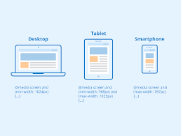
Media Queries
Media queries can be used to check:
width and height of the viewport
width and height of the device
orientation (landscape or portrait)
resolution
Popular technique for delivering a tailored style sheet to desktops, laptops, tablets, and mobile phones.
Notes:
@media screen and (min-width: 480px) { #leftsidebar {width: 200px; float: left;} #main {margin-left: 216px;} }
Media Queries For Menus
Media Queries For Columns

Slide 36
Conclusion

Slide 37

Making pixel perfect
Prepare images for devices with different pixel densities
Fonts
Line heights
Optimisations
Notes:
Eg oneplus website
Create three divs pixel perfect design
https://medium.com/pixelpoint/handoffs-guide-for-pixel-perfect-design-part-iii-3acc5a93d3a2

Slide 38
CSS coding best practices
Add a favicon in title section.
Use IDs really sparingly instead use classes.
Don’t create unnecessary classes eg. centerclass, whiteclass.
Avoid inline styling at all costs!
DRY- Don’t Repeat Yourself.
For general tags you can have general styling, but specific styling should be in specific class tags only.
Notes:
IDs should be used only for navigation and meaning and Scripting
Can get Navigation bars, dropdown menus, image gallery etc- w3schools.com and other resources
Cheatsheet- https://web.stanford.edu/group/csp/cs21/csscheatsheet.pdf
Make dry changes in the z index file and show

Slide 39
Summary
Including CSS
Selectors
Properties
Fonts
Table
Box model
Sizing
Positioning
Z index
Float
Classes and IDs
Conflict resolution- Heirarchy, specificity
Transitions
Animations
Reponsive web design- Grid system, Flexbox, media queries
Best practices
Notes:
Check this for the advanced selectors I explained- https://developer.mozilla.org/en-US/docs/Web/CSS/Attribute_selectors

Slide 40
Motivational tip
Stuck? Use google, stackoverflow etc. Paste the error code.
Never copy paste code that you don’t understand.
Part of being a good engineer is knowing how to google.

Slide 41
Assignment
Style your ecommerce home page created in the earlier assignment based upon the mockup provided
Add descriptive comments for everything you implement
Notes:
You can use https://www.cssportal.com/css3-button-generator/ and any other template of css but customise it for the mockups and add descriptive comments

Slide 42
Answer the following Questions
Which positioning removes the element from the document flow- absolute, static, relative or sticky?
What is the meaning of cascading? How do style sheets cascade?
What are the ways of defining color?
What are CSS Sprites?
What are the different media types allowed by CSS?
What are the different font-size units used in CSS?
What is the difference between {visibility: hidden} and {display: none}?
What is the cursor property?
What is a tooltip and how to include one in a webpage?

Slide 43
CSS specificity exercise
For the given html and css code- assignment.html in snippets folder, calculate specificity of each rule and give reason why the colors of each line are so.

